Slide 1

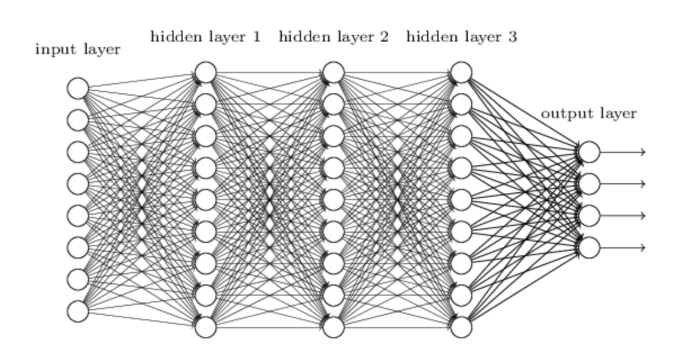
An introduction to supervised learning

Slide 2
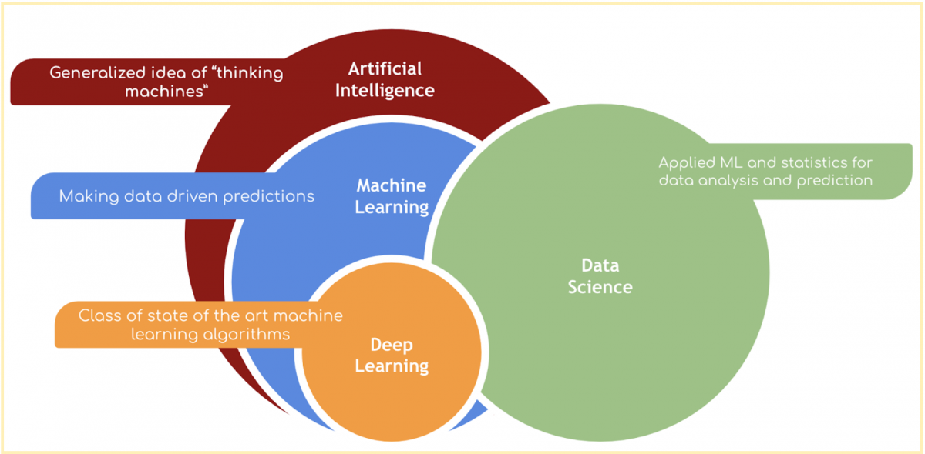
Supervised
Learning

Slide 3
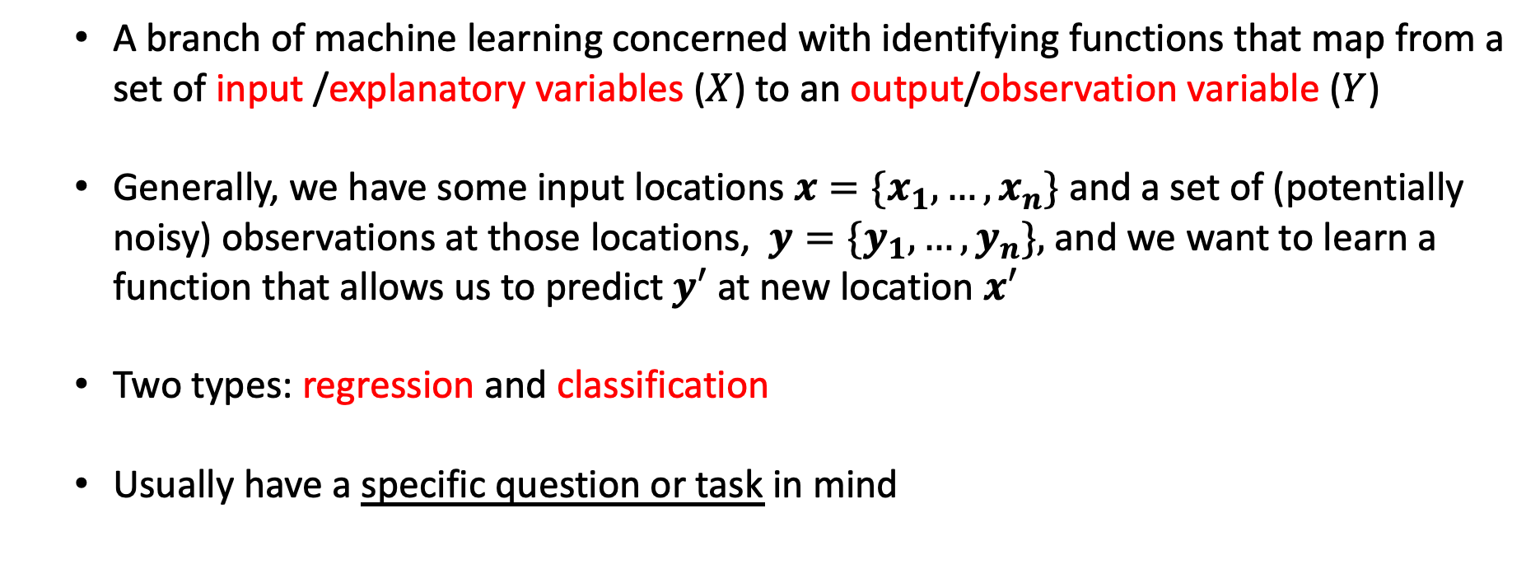
What is supervised learning?
A branch of machine learning concerned with identifying functions that map from a set of input /explanatory variables ($X$) to an output/observation variable ($Y$)
Generally, we have some input locations $x={\{x}_{1},…,x_{n}\}$ and a set of (potentially noisy) observations at those locations, $y={\{y}_{1},…,y_{n}\},$and we want to learn a function that allows us to predict$y′$ at new location $x′$
Two types: regression and classification
Usually have a specific question or task in mind

Slide 4
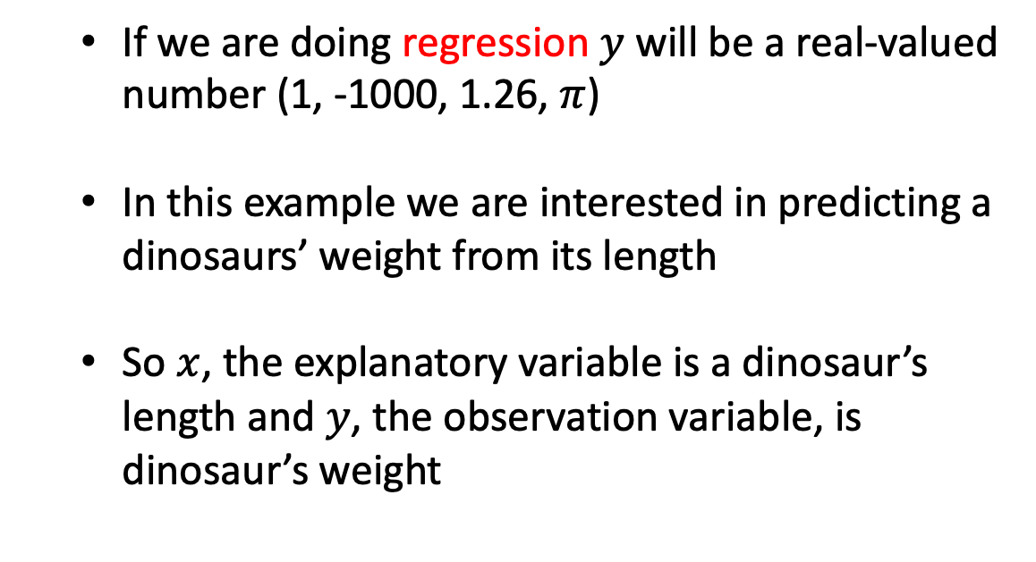
A typical dataset
If we are doing regression $y$ will be a real-valued number (1, -1000, 1.26, $π$)
In this example we are interested in predicting a dinosaurs’ weight from its length
So $x$, the explanatory variable is a dinosaur’s length and $y$, the observation variable, is dinosaur’s weight
Dinosaur | Height (m) | Length (m) | W (kg) | Type
Acrocanthosaurus (top-spined lizard) | 5.8 | 12.2 | 2,722 | Saurischian
Albertosaurus (Alberta lizard) | 4.6 | 9.1 | 2,722 | Saurischian
Allosaurus (other lizard) | 5.2 | 12.2 | 1,814 | Saurischian
Apatosaurus (deceptive lizard) | 4.5 | 22.9 | 29,937 | Saurischian
Archaeopteryx (ancient wing) | 0.3 | 0.9 | 0.9 | Saurischian
Argentinosaurus (Argentina lizard) | 21.4 | 36.6 | 99,792 | Saurischian
Baryonyx (heavy claws) | 1.8 | 9.1 | 1,814 | Saurischian
Brachiosaurus (arm lizard) | 15.2 | 30.5 | 45,360 | Saurischian
Ceratosaurus (horned lizard) | 4 | 6.1 | 1,361 | Saurischian
Coelophysis (hollow form) | 0.9 | 2.7 | 45.5 | Saurischian
Compsognathus (elegant jaw) | 0.6 | 0.9 | 3.6 | Saurischian
Deinonychus (terrible claw) | 1.5 | 2.7 | 80 | Saurischian
Diplodocus (double beam) | 7.3 | 27.1 | 22,680 | Saurischian
Dromiceiomimus (emu mimic) | 1.5 | 3.4 | 100 | Saurischian
Gallimimus (fowlmimic) | 2.4 | 5.5 | 118 | Saurischian
Mamenchisaurus (Mamenchi lizard) | 10.7 | 21 | 27,216 | Saurischian
Megalosaurus (big lizard) | 3.7 | 7.9 | 907 | Saurischian
Microvenator (small hunter) | 0.8 | 1.2 | 6.4 | Saurischian
Ornithomimus (bird mimic) | 2.4 | 4.6 | 136 | Saurischian
Oviraptor (egg robber) | 0.9 | 1.5 | 36 | Saurischian
Plateosaurus (flat lizard) | 2.1 | 7.9 | 1,814 | Saurischian
Saurornithoides (narrow-clawed lizard) | 0.9 | 2 | 27 | Saurischian
Seismosaurus (tremor lizard) | 25.6 | 45.7 | 90,720 | Saurischian
Spinosaurus (spiny lizard) | 2.4 | 12.2 | 6,350 | Saurischian
Supersaurus (super lizard) | 20.1 | 30.5 | 54,432 | Saurischian
Tyrannosaurus (tyrant lizard) | 7 | 15.2 | 6,350 | Saurischian
Ultrasauros (ultra lizard) | 16.2 | 30.5 | 63,504 | Saurischian
Velociraptor (swift robber) | 0.6 | 1.8 | 0.113 | Saurischian
Ankylosaurus (armored lizard) | 2.1 | 10.6 | 4,536 | Ornithischian
Camptosaurus (bent lizard) | 3 | 7 | 1,814 | Ornithischian
Chasmosaurus (cleft lizard) | 1.8 | 5.2 | 1,361 | Ornithischian
Claosaurus (broken lizard) | 1.8 | 3.7 | 907 | Ornithischian
Corythosaurus (helmet lizard) | 4.9 | 9.1 | 4,019 | Ornithischian
Dravidosaurus (Dravidanadu lizard) | 1.2 | 3 | 907 | Ornithischian

Slide 5
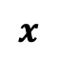
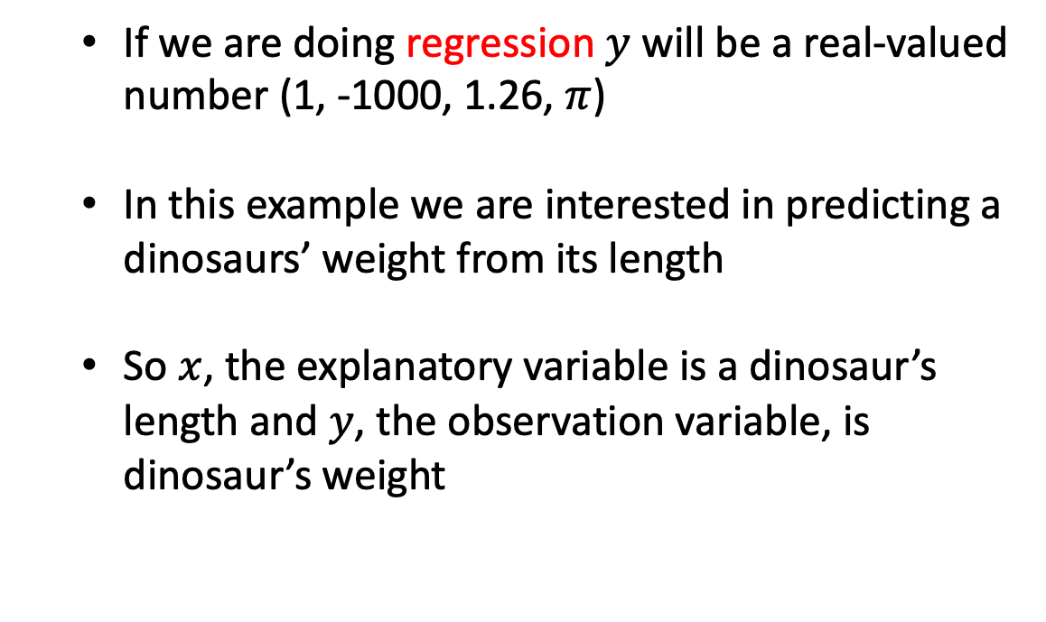
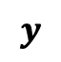
A typical dataset
$$x$$
$$y$$
If we are doing regression $y$ will be a real-valued number (1, -1000, 1.26, $π$)
In this example we are interested in predicting a dinosaurs’ weight from its length
So $x$, the explanatory variable is a dinosaur’s length and $y$, the observation variable, is dinosaur’s weight
Dinosaur | Height (m) | Length (m) | W (kg) | Type
Acrocanthosaurus (top-spined lizard) | 5.8 | 12.2 | 2,722 | Saurischian
Albertosaurus (Alberta lizard) | 4.6 | 9.1 | 2,722 | Saurischian
Allosaurus (other lizard) | 5.2 | 12.2 | 1,814 | Saurischian
Apatosaurus (deceptive lizard) | 4.5 | 22.9 | 29,937 | Saurischian
Archaeopteryx (ancient wing) | 0.3 | 0.9 | 0.9 | Saurischian
Argentinosaurus (Argentina lizard) | 21.4 | 36.6 | 99,792 | Saurischian
Baryonyx (heavy claws) | 1.8 | 9.1 | 1,814 | Saurischian
Brachiosaurus (arm lizard) | 15.2 | 30.5 | 45,360 | Saurischian
Ceratosaurus (horned lizard) | 4 | 6.1 | 1,361 | Saurischian
Coelophysis (hollow form) | 0.9 | 2.7 | 45.5 | Saurischian
Compsognathus (elegant jaw) | 0.6 | 0.9 | 3.6 | Saurischian
Deinonychus (terrible claw) | 1.5 | 2.7 | 80 | Saurischian
Diplodocus (double beam) | 7.3 | 27.1 | 22,680 | Saurischian
Dromiceiomimus (emu mimic) | 1.5 | 3.4 | 100 | Saurischian
Gallimimus (fowlmimic) | 2.4 | 5.5 | 118 | Saurischian
Mamenchisaurus (Mamenchi lizard) | 10.7 | 21 | 27,216 | Saurischian
Megalosaurus (big lizard) | 3.7 | 7.9 | 907 | Saurischian
Microvenator (small hunter) | 0.8 | 1.2 | 6.4 | Saurischian
Ornithomimus (bird mimic) | 2.4 | 4.6 | 136 | Saurischian
Oviraptor (egg robber) | 0.9 | 1.5 | 36 | Saurischian
Plateosaurus (flat lizard) | 2.1 | 7.9 | 1,814 | Saurischian
Saurornithoides (narrow-clawed lizard) | 0.9 | 2 | 27 | Saurischian
Seismosaurus (tremor lizard) | 25.6 | 45.7 | 90,720 | Saurischian
Spinosaurus (spiny lizard) | 2.4 | 12.2 | 6,350 | Saurischian
Supersaurus (super lizard) | 20.1 | 30.5 | 54,432 | Saurischian
Tyrannosaurus (tyrant lizard) | 7 | 15.2 | 6,350 | Saurischian
Ultrasauros (ultra lizard) | 16.2 | 30.5 | 63,504 | Saurischian
Velociraptor (swift robber) | 0.6 | 1.8 | 0.113 | Saurischian
Ankylosaurus (armored lizard) | 2.1 | 10.6 | 4,536 | Ornithischian
Camptosaurus (bent lizard) | 3 | 7 | 1,814 | Ornithischian
Chasmosaurus (cleft lizard) | 1.8 | 5.2 | 1,361 | Ornithischian
Claosaurus (broken lizard) | 1.8 | 3.7 | 907 | Ornithischian
Corythosaurus (helmet lizard) | 4.9 | 9.1 | 4,019 | Ornithischian
Dravidosaurus (Dravidanadu lizard) | 1.2 | 3 | 907 | Ornithischian

Slide 6
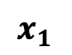
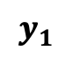
A typical dataset
$$x_{1}$$
$$y_{1}$$
If we are doing regression $y$ will be a real-valued number (1, -1000, 1.26, $π$)
In this example we are interested in predicting a dinosaurs’ weight from its length
So $x$, the explanatory variable is a dinosaur’s length and $y$, the observation variable, is dinosaur’s weight
Dinosaur | Height (m) | Length (m) | W (kg) | Type
Acrocanthosaurus (top-spined lizard) | 5.8 | 12.2 | 2,722 | Saurischian
Albertosaurus (Alberta lizard) | 4.6 | 9.1 | 2,722 | Saurischian
Allosaurus (other lizard) | 5.2 | 12.2 | 1,814 | Saurischian
Apatosaurus (deceptive lizard) | 4.5 | 22.9 | 29,937 | Saurischian
Archaeopteryx (ancient wing) | 0.3 | 0.9 | 0.9 | Saurischian
Argentinosaurus (Argentina lizard) | 21.4 | 36.6 | 99,792 | Saurischian
Baryonyx (heavy claws) | 1.8 | 9.1 | 1,814 | Saurischian
Brachiosaurus (arm lizard) | 15.2 | 30.5 | 45,360 | Saurischian
Ceratosaurus (horned lizard) | 4 | 6.1 | 1,361 | Saurischian
Coelophysis (hollow form) | 0.9 | 2.7 | 45.5 | Saurischian
Compsognathus (elegant jaw) | 0.6 | 0.9 | 3.6 | Saurischian
Deinonychus (terrible claw) | 1.5 | 2.7 | 80 | Saurischian
Diplodocus (double beam) | 7.3 | 27.1 | 22,680 | Saurischian
Dromiceiomimus (emu mimic) | 1.5 | 3.4 | 100 | Saurischian
Gallimimus (fowlmimic) | 2.4 | 5.5 | 118 | Saurischian
Mamenchisaurus (Mamenchi lizard) | 10.7 | 21 | 27,216 | Saurischian
Megalosaurus (big lizard) | 3.7 | 7.9 | 907 | Saurischian
Microvenator (small hunter) | 0.8 | 1.2 | 6.4 | Saurischian
Ornithomimus (bird mimic) | 2.4 | 4.6 | 136 | Saurischian
Oviraptor (egg robber) | 0.9 | 1.5 | 36 | Saurischian
Plateosaurus (flat lizard) | 2.1 | 7.9 | 1,814 | Saurischian
Saurornithoides (narrow-clawed lizard) | 0.9 | 2 | 27 | Saurischian
Seismosaurus (tremor lizard) | 25.6 | 45.7 | 90,720 | Saurischian
Spinosaurus (spiny lizard) | 2.4 | 12.2 | 6,350 | Saurischian
Supersaurus (super lizard) | 20.1 | 30.5 | 54,432 | Saurischian
Tyrannosaurus (tyrant lizard) | 7 | 15.2 | 6,350 | Saurischian
Ultrasauros (ultra lizard) | 16.2 | 30.5 | 63,504 | Saurischian
Velociraptor (swift robber) | 0.6 | 1.8 | 0.113 | Saurischian
Ankylosaurus (armored lizard) | 2.1 | 10.6 | 4,536 | Ornithischian
Camptosaurus (bent lizard) | 3 | 7 | 1,814 | Ornithischian
Chasmosaurus (cleft lizard) | 1.8 | 5.2 | 1,361 | Ornithischian
Claosaurus (broken lizard) | 1.8 | 3.7 | 907 | Ornithischian
Corythosaurus (helmet lizard) | 4.9 | 9.1 | 4,019 | Ornithischian
Dravidosaurus (Dravidanadu lizard) | 1.2 | 3 | 907 | Ornithischian

Slide 7
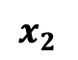
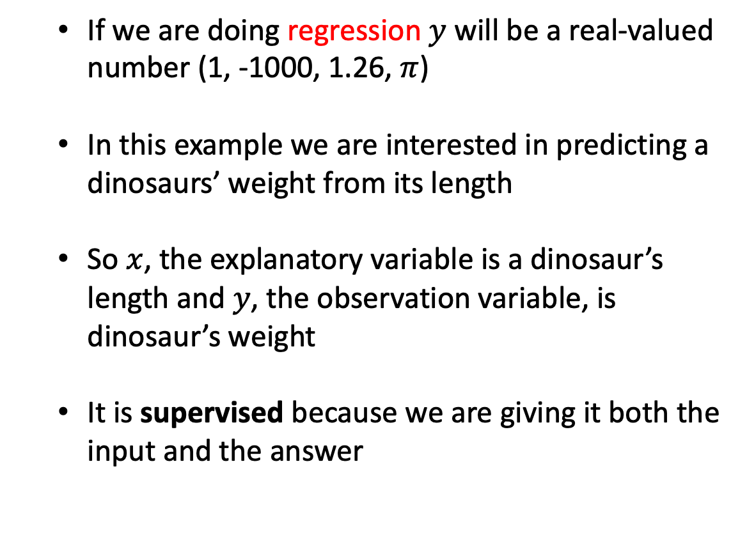
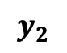
A typical dataset
$$x_{2}$$
$$y_{2}$$
If we are doing regression $y$ will be a real-valued number (1, -1000, 1.26, $π$)
In this example we are interested in predicting a dinosaurs’ weight from its length
So $x$, the explanatory variable is a dinosaur’s length and $y$, the observation variable, is dinosaur’s weight
It is supervised because we are giving it both the input and the answer
Dinosaur | Height (m) | Length (m) | W (kg) | Type
Acrocanthosaurus (top-spined lizard) | 5.8 | 12.2 | 2,722 | Saurischian
Albertosaurus (Alberta lizard) | 4.6 | 9.1 | 2,722 | Saurischian
Allosaurus (other lizard) | 5.2 | 12.2 | 1,814 | Saurischian
Apatosaurus (deceptive lizard) | 4.5 | 22.9 | 29,937 | Saurischian
Archaeopteryx (ancient wing) | 0.3 | 0.9 | 0.9 | Saurischian
Argentinosaurus (Argentina lizard) | 21.4 | 36.6 | 99,792 | Saurischian
Baryonyx (heavy claws) | 1.8 | 9.1 | 1,814 | Saurischian
Brachiosaurus (arm lizard) | 15.2 | 30.5 | 45,360 | Saurischian
Ceratosaurus (horned lizard) | 4 | 6.1 | 1,361 | Saurischian
Coelophysis (hollow form) | 0.9 | 2.7 | 45.5 | Saurischian
Compsognathus (elegant jaw) | 0.6 | 0.9 | 3.6 | Saurischian
Deinonychus (terrible claw) | 1.5 | 2.7 | 80 | Saurischian
Diplodocus (double beam) | 7.3 | 27.1 | 22,680 | Saurischian
Dromiceiomimus (emu mimic) | 1.5 | 3.4 | 100 | Saurischian
Gallimimus (fowlmimic) | 2.4 | 5.5 | 118 | Saurischian
Mamenchisaurus (Mamenchi lizard) | 10.7 | 21 | 27,216 | Saurischian
Megalosaurus (big lizard) | 3.7 | 7.9 | 907 | Saurischian
Microvenator (small hunter) | 0.8 | 1.2 | 6.4 | Saurischian
Ornithomimus (bird mimic) | 2.4 | 4.6 | 136 | Saurischian
Oviraptor (egg robber) | 0.9 | 1.5 | 36 | Saurischian
Plateosaurus (flat lizard) | 2.1 | 7.9 | 1,814 | Saurischian
Saurornithoides (narrow-clawed lizard) | 0.9 | 2 | 27 | Saurischian
Seismosaurus (tremor lizard) | 25.6 | 45.7 | 90,720 | Saurischian
Spinosaurus (spiny lizard) | 2.4 | 12.2 | 6,350 | Saurischian
Supersaurus (super lizard) | 20.1 | 30.5 | 54,432 | Saurischian
Tyrannosaurus (tyrant lizard) | 7 | 15.2 | 6,350 | Saurischian
Ultrasauros (ultra lizard) | 16.2 | 30.5 | 63,504 | Saurischian
Velociraptor (swift robber) | 0.6 | 1.8 | 0.113 | Saurischian
Ankylosaurus (armored lizard) | 2.1 | 10.6 | 4,536 | Ornithischian
Camptosaurus (bent lizard) | 3 | 7 | 1,814 | Ornithischian
Chasmosaurus (cleft lizard) | 1.8 | 5.2 | 1,361 | Ornithischian
Claosaurus (broken lizard) | 1.8 | 3.7 | 907 | Ornithischian
Corythosaurus (helmet lizard) | 4.9 | 9.1 | 4,019 | Ornithischian
Dravidosaurus (Dravidanadu lizard) | 1.2 | 3 | 907 | Ornithischian

Slide 8
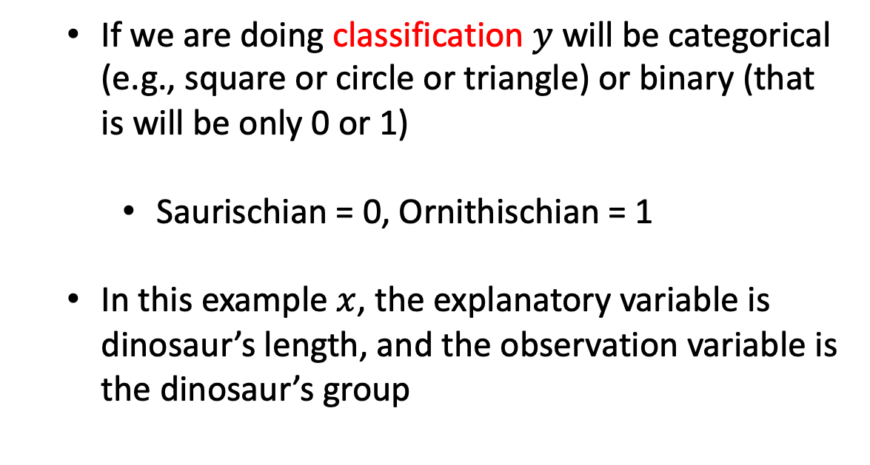
A typical dataset
$$x$$
$$y$$
If we are doing classification $y$ will be categorical (e.g., square or circle or triangle) or binary (that is will be only 0 or 1)
Saurischian = 0, Ornithischian = 1
In this example $x$, the explanatory variable is dinosaur’s length, and the observation variable is the dinosaur’s group
Dinosaur | Height (m) | Length (m) | W (kg) | Type
Acrocanthosaurus (top-spined lizard) | 5.8 | 12.2 | 2,722 | Saurischian
Albertosaurus (Alberta lizard) | 4.6 | 9.1 | 2,722 | Saurischian
Allosaurus (other lizard) | 5.2 | 12.2 | 1,814 | Saurischian
Apatosaurus (deceptive lizard) | 4.5 | 22.9 | 29,937 | Saurischian
Archaeopteryx (ancient wing) | 0.3 | 0.9 | 0.9 | Saurischian
Argentinosaurus (Argentina lizard) | 21.4 | 36.6 | 99,792 | Saurischian
Baryonyx (heavy claws) | 1.8 | 9.1 | 1,814 | Saurischian
Brachiosaurus (arm lizard) | 15.2 | 30.5 | 45,360 | Saurischian
Ceratosaurus (horned lizard) | 4 | 6.1 | 1,361 | Saurischian
Coelophysis (hollow form) | 0.9 | 2.7 | 45.5 | Saurischian
Compsognathus (elegant jaw) | 0.6 | 0.9 | 3.6 | Saurischian
Deinonychus (terrible claw) | 1.5 | 2.7 | 80 | Saurischian
Diplodocus (double beam) | 7.3 | 27.1 | 22,680 | Saurischian
Dromiceiomimus (emu mimic) | 1.5 | 3.4 | 100 | Saurischian
Gallimimus (fowlmimic) | 2.4 | 5.5 | 118 | Saurischian
Mamenchisaurus (Mamenchi lizard) | 10.7 | 21 | 27,216 | Saurischian
Megalosaurus (big lizard) | 3.7 | 7.9 | 907 | Saurischian
Microvenator (small hunter) | 0.8 | 1.2 | 6.4 | Saurischian
Ornithomimus (bird mimic) | 2.4 | 4.6 | 136 | Saurischian
Oviraptor (egg robber) | 0.9 | 1.5 | 36 | Saurischian
Plateosaurus (flat lizard) | 2.1 | 7.9 | 1,814 | Saurischian
Saurornithoides (narrow-clawed lizard) | 0.9 | 2 | 27 | Saurischian
Seismosaurus (tremor lizard) | 25.6 | 45.7 | 90,720 | Saurischian
Spinosaurus (spiny lizard) | 2.4 | 12.2 | 6,350 | Saurischian
Supersaurus (super lizard) | 20.1 | 30.5 | 54,432 | Saurischian
Tyrannosaurus (tyrant lizard) | 7 | 15.2 | 6,350 | Saurischian
Ultrasauros (ultra lizard) | 16.2 | 30.5 | 63,504 | Saurischian
Velociraptor (swift robber) | 0.6 | 1.8 | 0.113 | Saurischian
Ankylosaurus (armored lizard) | 2.1 | 10.6 | 4,536 | Ornithischian
Camptosaurus (bent lizard) | 3 | 7 | 1,814 | Ornithischian
Chasmosaurus (cleft lizard) | 1.8 | 5.2 | 1,361 | Ornithischian
Claosaurus (broken lizard) | 1.8 | 3.7 | 907 | Ornithischian
Corythosaurus (helmet lizard) | 4.9 | 9.1 | 4,019 | Ornithischian
Dravidosaurus (Dravidanadu lizard) | 1.2 | 3 | 907 | Ornithischian

Slide 9
What is supervised learning?
Why are we interested in finding a relationships between an observation variable and several explanatory variables?
Often explanatory variables are cheaper/easier to measure but we’re interested in is the observation variable
Allow us to make predictions at new locations (forecasting, decision making)
Allow us to distinguish between models (model structure, hypothesis testing, insight)
This function itself can tell us something about the nature of the system (linear, exponential, circadian, or which variables are important)

Slide 10
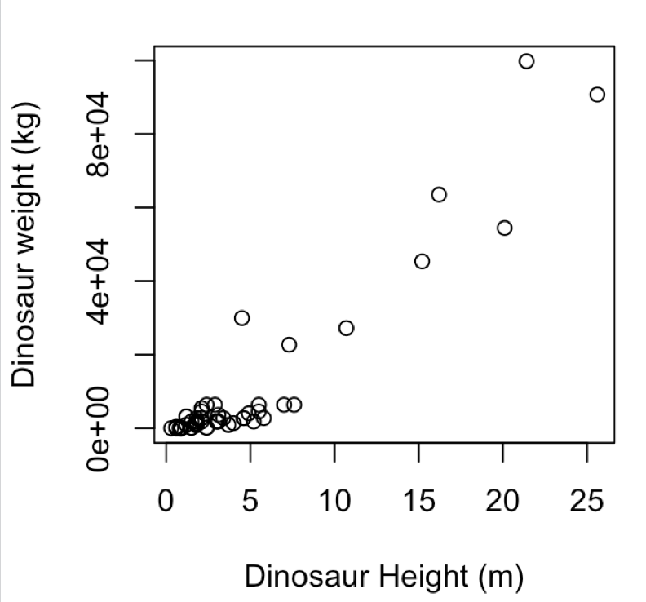
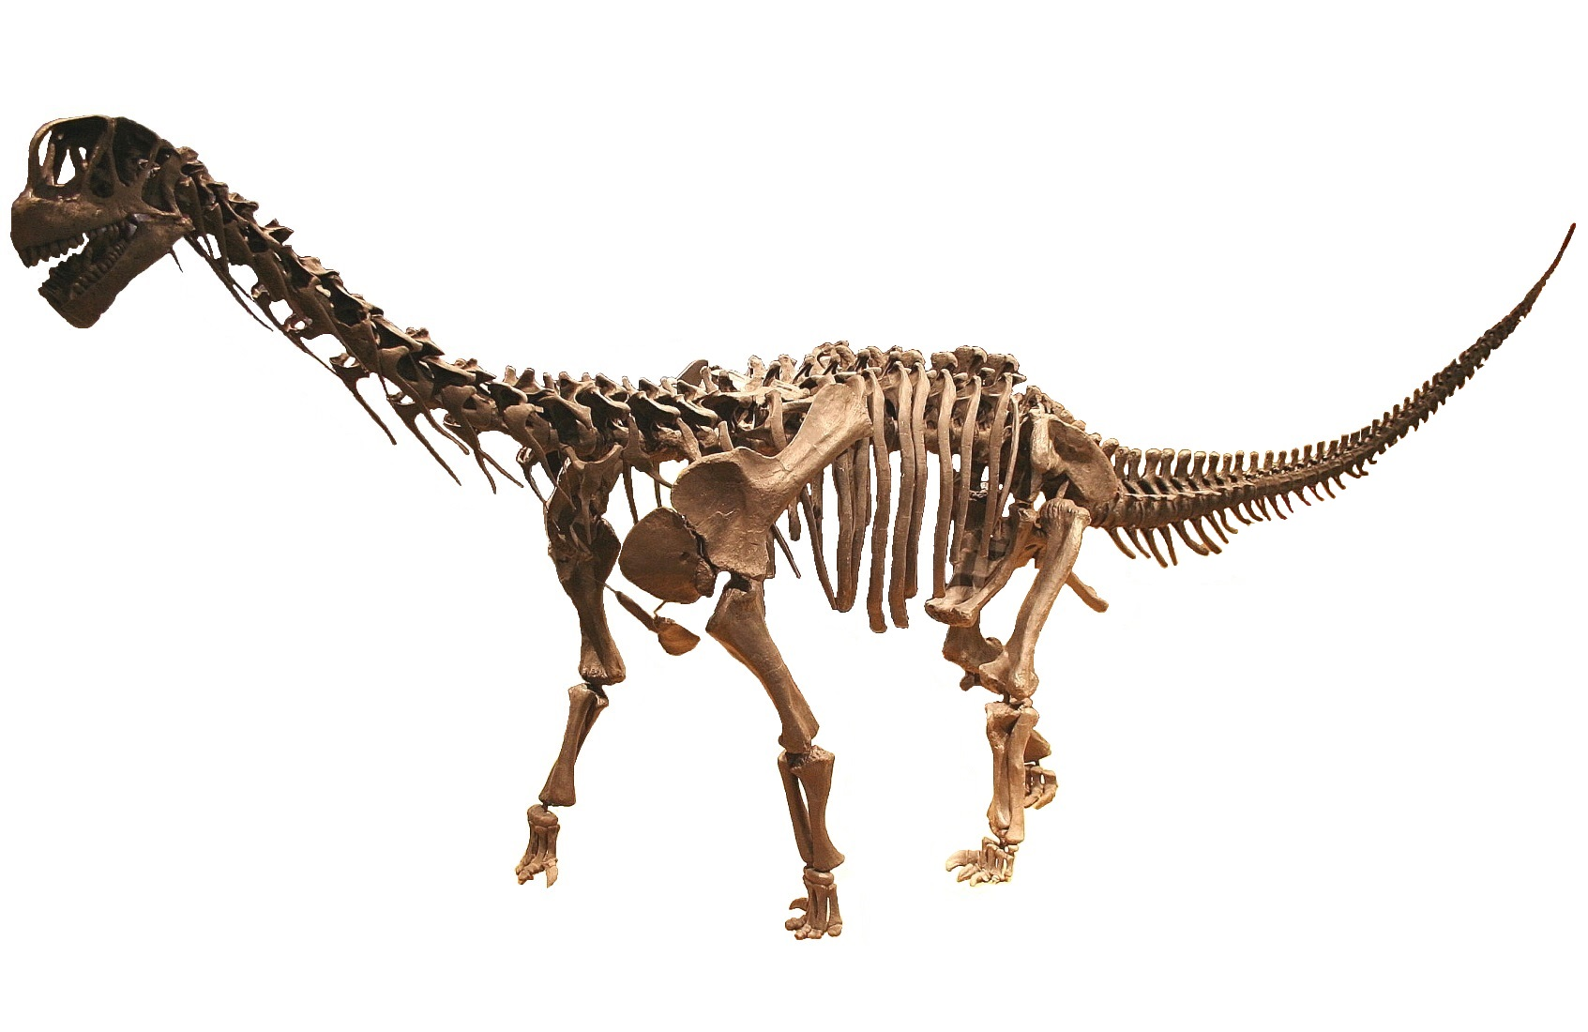
We first need a model
How do we quantify this relationship?
Need a model
Something that captures our expectation about the relationship
Predict at new locations
Usually has some parameters
data/Dinosaurs.csv

Slide 11
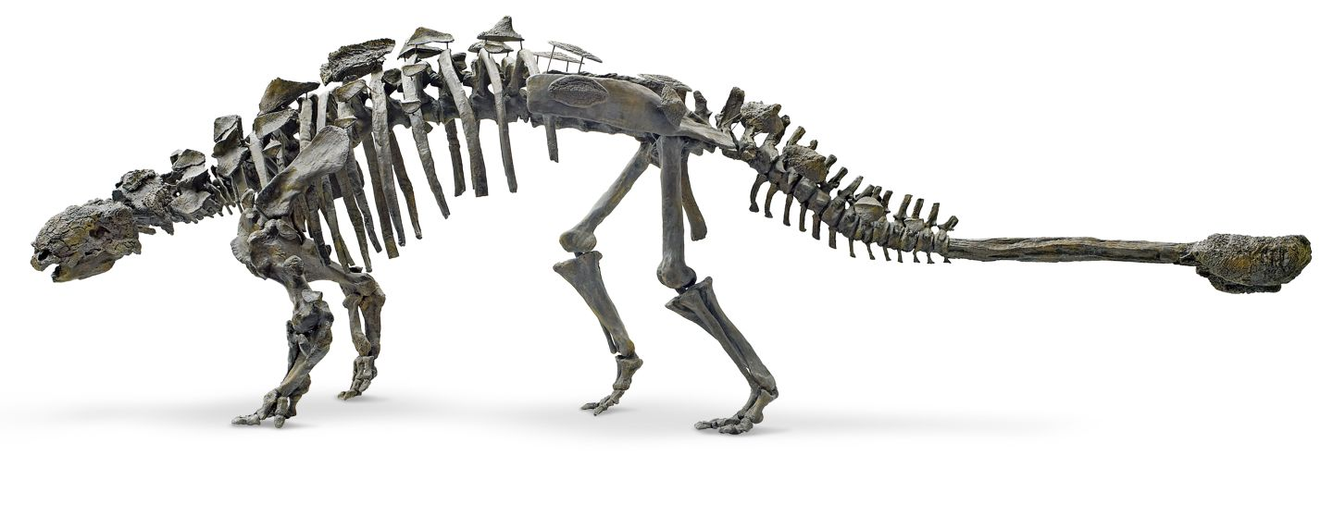
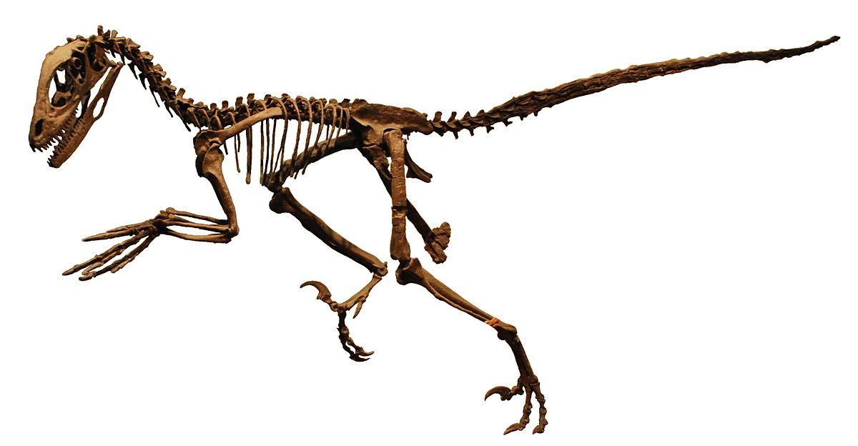
What is linear regression?
How do we quantify this relationship?
When m = 0 we have a flat line
When c = 0 we have a line that passes through (0,0).
intercept
y = m x + c
gradient

Slide 12
What is linear regression?
How do we quantify this relationship?
m
y = m x + c
c = 0, m = (1000-0)/(25-0)
c
y = 40 x + 0

Slide 13
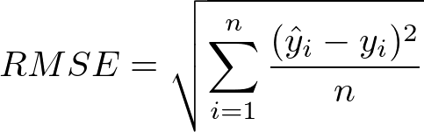
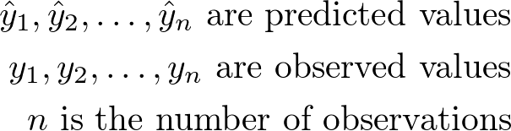
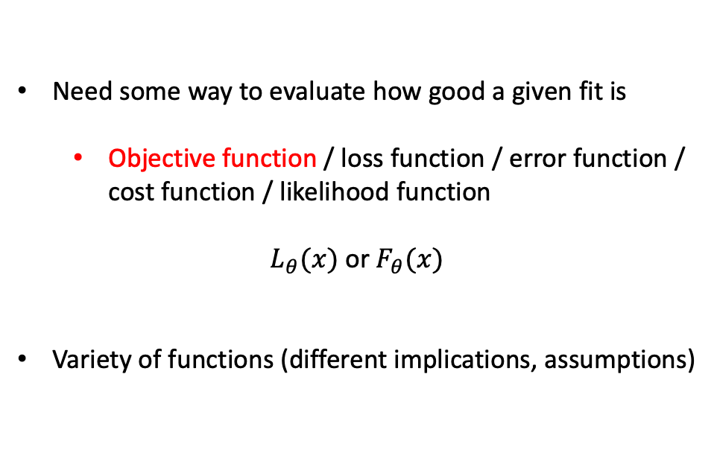
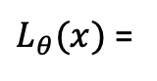
We need an objective function
Need some way to evaluate how good a given fit is
Objective function / loss function / error function / cost function / likelihood function
$L_{θ}(x)$ or $F_{θ}(x)$
Variety of functions (different implications, assumptions)
$L_{θ}(x)$ =

Slide 14
What is linear regression?
How do we quantify this relationship?
y = m x + c
c = 0, m = (1000-0)/(25-0)
y = 40 x + 0

Slide 15

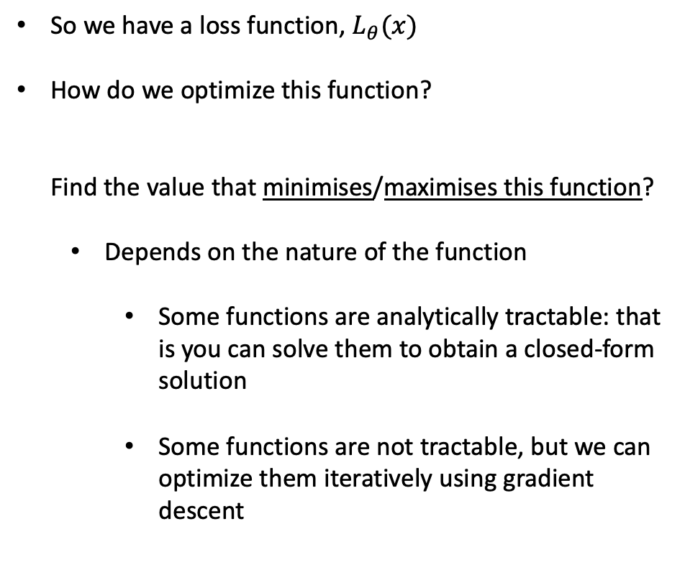
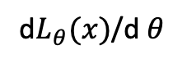
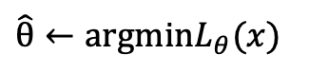
Need a way to optimise
So we have a loss function, $L_{θ}(x)$
How do we optimize this function? Find the value that minimises/maximises this function?
Depends on the nature of the function
Some functions are analytically tractable: that is you can solve them to obtain a closed-form solution
Some functions are not tractable, but we can optimize them iteratively using gradient descent
$\hat{θ}←argminL_{θ}(x)$
d$L_{θ}(x)$/d $θ$
https://blog.paperspace.com/intro-to-optimization-in-deep-learning-gradient-descent/

Slide 16
Need a way to optimise
Some functions will be highly multimodal
Gradient search doesn’t necessarily find the best value
Parameter spaces can be very large

Slide 17

Training set/test set
Typically, we break data down into training and test sets
60/40 – 80/20 split
Save the hold out data to evaluate the model or to compare different models
Sometimes even training/validation/test sets
70/20/10
In training data use k-fold cross validation
Typical 10-fold cross validation
Robustness and uncertainty

Slide 18
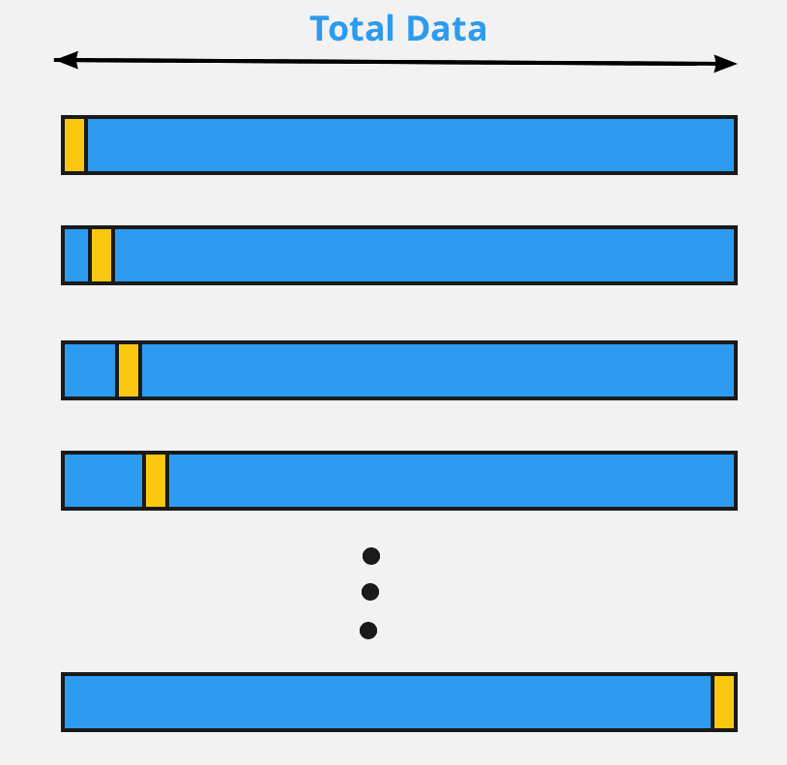
Training set/test set
What if my dataset is small?
Leave one out cross validation

Slide 19
Observation variable
Explanatory variable

Slide 20
Randomly select a training set

Slide 21
SSE
Try different values of (m, c) and evaluate the sum squared error (SSE):
∑ ( (y_{pred} – y_{observed})² )
(here we fix c to the true value and just look at varying m)
m

Slide 26
This model is slightly worse than the previous one

Slide 28
What is linear regression?
Learn parameters (c, m) that minimize an error (here we used SSE)
In this example we iterated over values of m
Is analytically tractable (can solve it to find the value in terms of an equation)
Can predict the values of y* at new location x* (forecasting/decision making)
In this case the best model (minimizing SSE) doesn’t do so well for larger dinosaurs

Slide 29
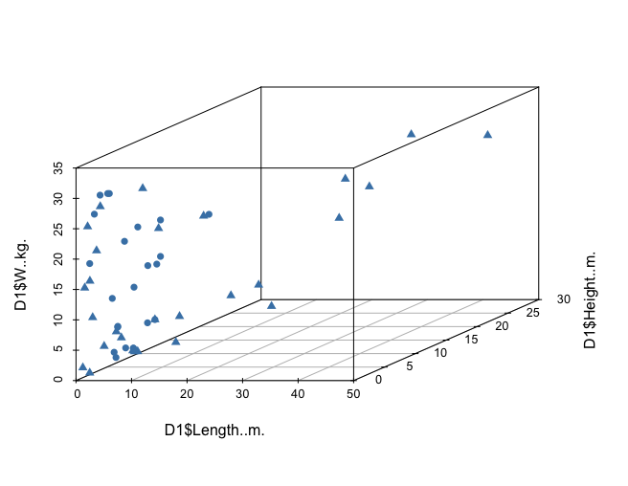
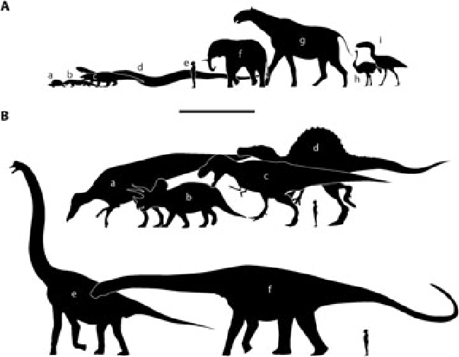
`
Multiple explanatory variables
Dinosaur weight (kg)
Dinosaur height (m)
Dinosaur length (m)
z = m₁ x + m₂ y + c
Our model for z is a linear combination of input variables
R PSEUDOCODE
lrfit <- train(z ~ x + y, data, method = "lm")

Slide 30
`
Multiple explanatory variables

Slide 31
`
Multiple explanatory variables

Slide 32
`
Multiple explanatory variables

Slide 33
`
Multiple explanatory variables
SSE
m₂
m₁
z = m₁ x + m₂ y + c

Slide 34
`
Multiple explanatory variables
SSE
m₂
m₁
z = m₁ x + m₂ y + c

Slide 35
`
Multiple explanatory variables
z = m₁ x + m₂ y + c
Our model for z is a linear combination of input variables
Parameters are important If m₁ is small than the variable x doesn’t have much of an impact on inference
Some objective functions have additional terms to favour sparsity i.e., m small for most variables
Dinosaur weight (kg)
Dinosaur height (m)
Dinosaur length (m)
R PSEUDOCODE
lrfit <- train(z ~ x + y, data, method = "lm")

Slide 36
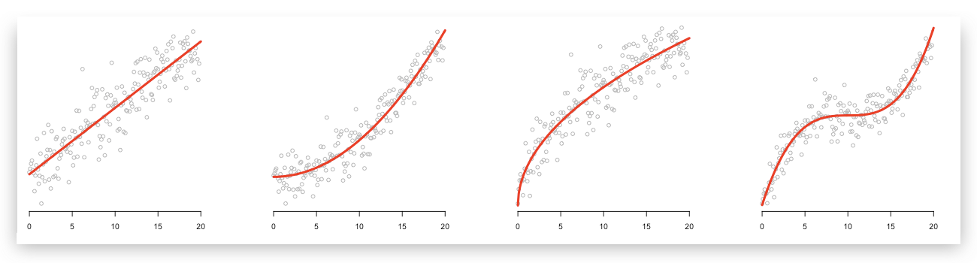
Beyond linear regression
m
c
R PSEUDOCODE
y = m x + c
lrfit <- train(y~., x, method = "lm")

Slide 37
Polynomial regression
y = m₁ x² + m₂ x + c
R PSEUDOCODE
y = m₃ x³ m₂ x² + m₁ x + c
lrfit <- train(y~poly(x,degree=3), data, method = "lm")
y = ∑ m_{i} x^{i} + c

Slide 38
Polynomial regression
y = m₁ x² + m₂ x + c
Note: observation data is nonlinear … but we are using a linear model
Observations= (x,x²,x³,…,x^{i}) are fixed input variables
Our model for y is a linear combination of input variables
Parameters = (m₁ , m₂ , … , m_{n} , c) are optimised
y = m₃ x³ m₂ x² + m₁ x + c
y = ∑ m_{i} x^{i} + c

Slide 39
Linear models
Linear combination of input variables:
Not a linear combination of input variables:
y = m₁ x² + m₂ x + c
y = m₃ x³ m₂ x² + m₁ x + c
y = m₁ x² y + c
y = ∑ m_{i} x^{i} + c
y = m₃ x³ m₂ x² + m₁ x z + c
y = m₁ x² + m₂ y + c
y = m₃ x³ + m₂ x² + m₁ z + c

Slide 40
Polynomial regression

Slide 41
Evaluating performance

Slide 42
Evaluating performance
Underfitting
Over-fitting

Slide 43
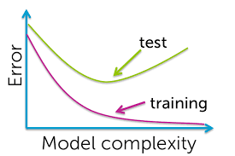
Evaluating performance

Slide 44
What about classification?

Slide 45
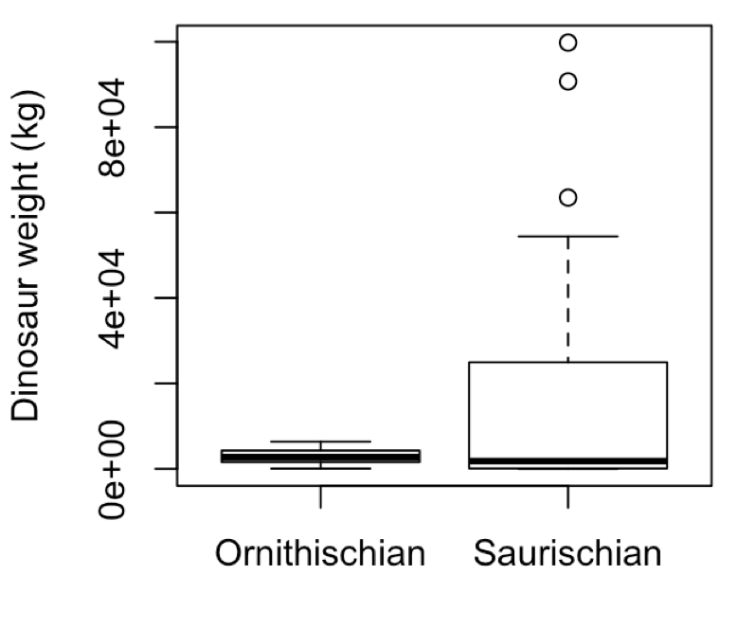
Logistic regression
Logistic regression
Is there a relationship between a dinosaur’s size and its (sub)order? Can we predict the the dinosaurs order given just measurement of its size?

Slide 46
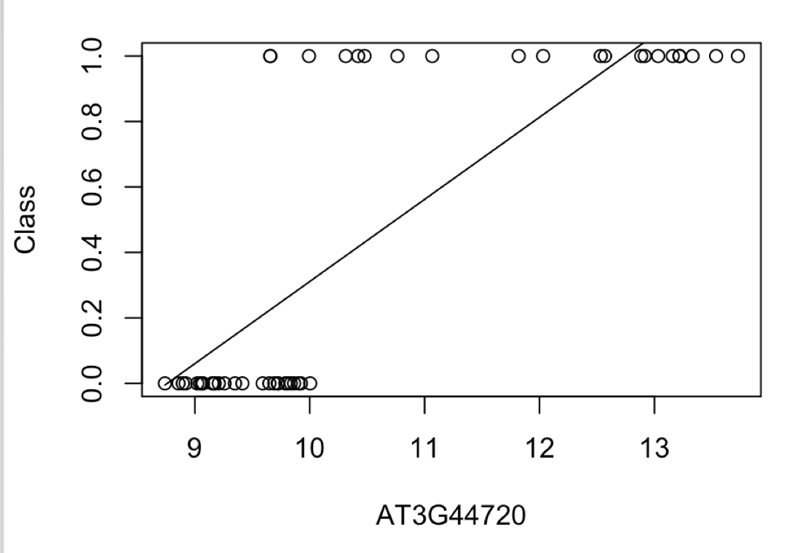
Logistic regression
Explanatory variable x is continuous, but we have binary valued outputs, y
Linear/polynomial regression is no good!
Need a model that correctly accounts for the type of data we have
Suborder
Dinosaur weight/height/length

Slide 47
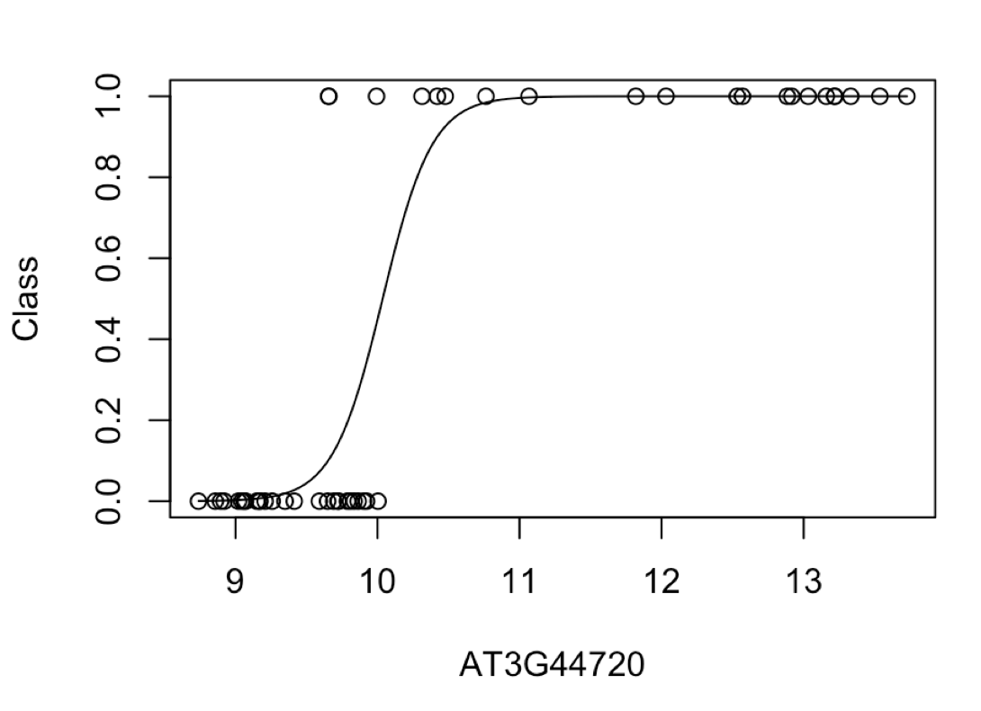
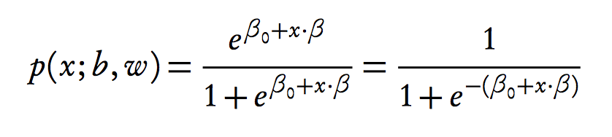
Logistic regression
Model the probability of success using a logistic function

Slide 48
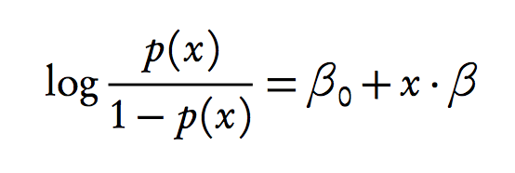
Logistic regression
Model log odds as liner model:
Solve for x
R PSEUDOCODE
lrfit <- train(y ~ x, data, method="glm", family="binomial")

Slide 49
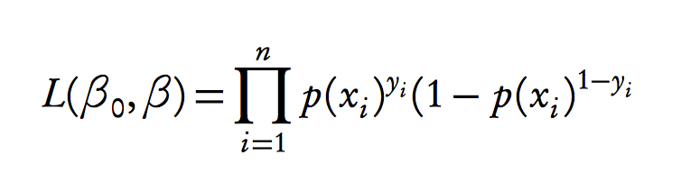
Logistic regression
Model log odds as liner model:
Solve for x
Likelihood
)
R PSEUDOCODE
lrfit <- train(y ~ x, data, method="glm", family="binomial")
Using held out data find parameters that maximises this
likelihood

Slide 50
Logistic regression
Model log odds as liner model:
Solve for x
Likelihood
)
Using held out data find parameters that maximises this
likelihood

Slide 51
Logistic regression
Likelihood
)

Slide 52
Logistic regression
Likelihood
)
P(y_{i}=1) = 0.51

Slide 53
Logistic regression
Likelihood
)
P(y_{i}=1) = 0.91

Slide 54
Logistic regression
Likelihood
)
P(y_{i}=1) = 0.91
x = (x₁, x₂, x₃, …, x_{n-1}, x_{n})
y = (0, 0, 1, …, 1, 1)
L = p(y₁=0) x p(y₂=0) x p(y₃=1) x … x p(y_{n}=1) x p(y_{n}=1 )
Give and value of beta0 and beta1 what’s the probability we see the sequence of data y = (y₁,…,y_{n})

Slide 55
Logistic regression
Likelihood
)
Other values for betas?

Slide 56
Logistic regression

Slide 57
Logistic regression
R PSEUDOCODE
lrfit <- train(y ~ x + z, data, method="glm", family="binomial")
Multiple input variables

Slide 58
Recap: evaluating performance
Evaluating using sum of squared error is a poor choice for performance.

Slide 59
Receiver operating characteristics (ROC)
Evaluating using sum of squared error is a poor choice for performance.
Count number of correct/incorrect classifications
True positive: Predict y = 1, observation y = 1.
True negative: Predict y = 0, observation y = 0.
False positive: Predict y = 1, observation y = 0.
False negative: Predict y = 0, observation y = 1.
Plot false positive rate (FPR) versus true positive rate (TPR).
Receiver operating characteristic curve

Slide 60
ROC
TPR = TP/(TP+FN)
Sensitivity
FPR = FP/(FP+TN)
Fallout

Slide 61
ROC
TPR = TP/(TP+FN)
Sensitivity
FPR = FP/(FP+TN)
Fallout

Slide 62
ROC
TPR = TP/(TP+FN)
Sensitivity
AUC = 1 (perfect classification)
AUC = 0.5 (random classification)
FPR = FP/(FP+TN)
Fallout

Slide 63

Repeatability?
In many cases ML has a strong empirical emphasis (statistics still playing catch up)
Need to ensure work is repeatable. How?
Available data
Open-source code: GitHub or other repositories
Documenting codebase (version control or Docker)
Setting the (pseudo) random number generators (setting the seed)
A pseudo-random number generator is an endlessly repeating fixed list of numbers.

Slide 64
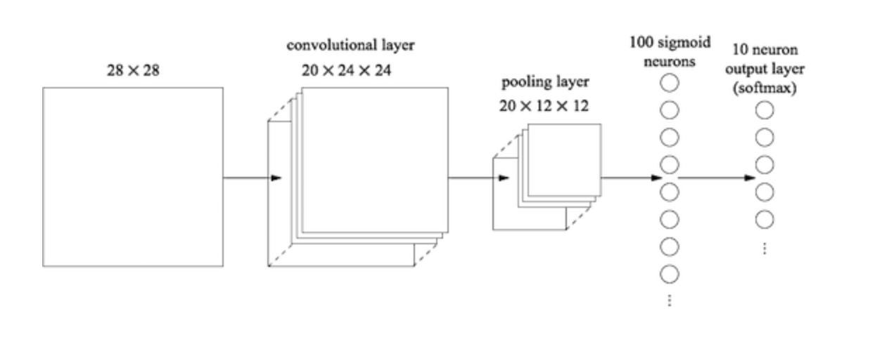
Multilayer neural networks

Slide 65
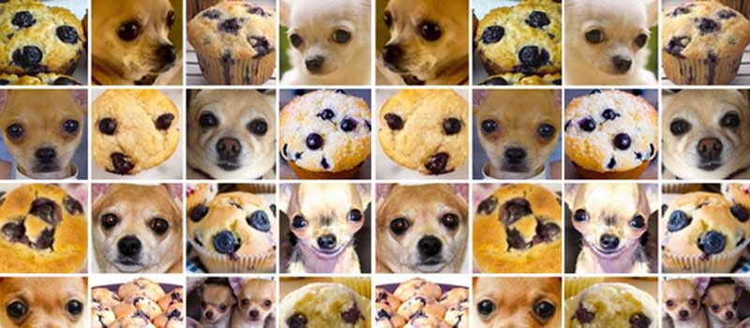
Introduction to multilayer neural networks
Introduce you to the basics of neural networks and multilayer neural networks (MLNNs) aka “deep learning”
Cover basic terminology
Highlight some limitations of MLNNs
Construct some basic neural networks for regression and image analysis
#ChihuahuaOrMuffin

Slide 66
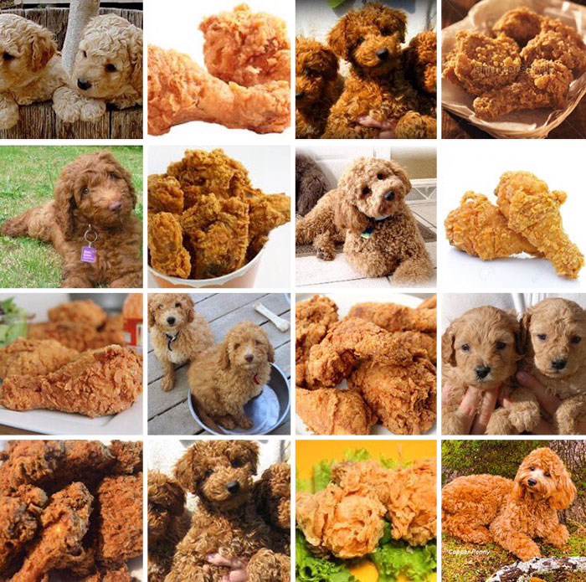
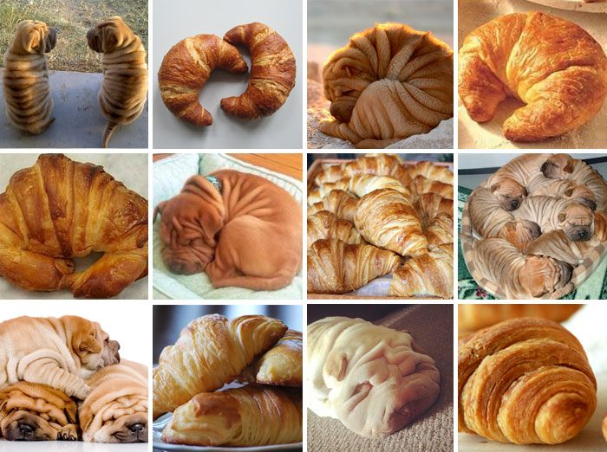

Introduction to multilayer neural networks
#LabradoodleOrFriedChicken
#SharPeiOrCroissant

Slide 67
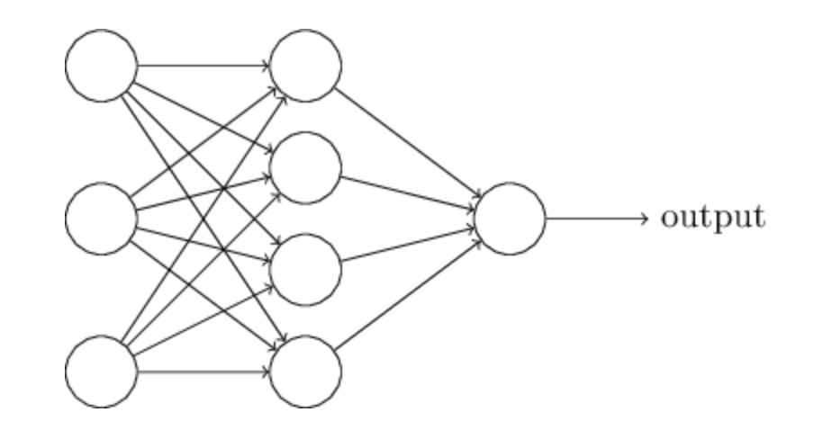
Neural networks
Input
Hidden
Output
Example: 3-input nodes = 3D input
1-output nodes = 1D input
(Nielsen, Neural networks and deep learning)
Neural network: Input nodes → one hidden layer nodes → output nodes

Slide 68
Neural networks

Slide 69
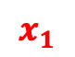
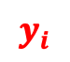
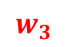

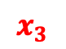

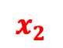
Neural networks
$$x_{1}$$
$$w_{1}$$
$$x_{2}$$
$$w_{2}$$
$$y_{i}$$
$$w_{3}$$
$$x_{3}$$
$$y_{i}=w_{1}x_{1}+w_{2}x_{2}+w_{3}x_{3}+bias$$

Slide 70
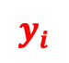





Neural networks
$$x_{1}$$
$$w_{1}$$
$$x_{2}$$
$$w_{2}$$
$$y_{i}$$
$$w_{3}$$
$$x_{3}$$
$$y_{i}=w_{1}x_{1}+w_{2}x_{2}+w_{3}x_{3}+bias$$
$$y_{i}=f(w_{1}x_{1}+w_{2}x_{2}+w_{3}x_{3}+bias)$$

Slide 71
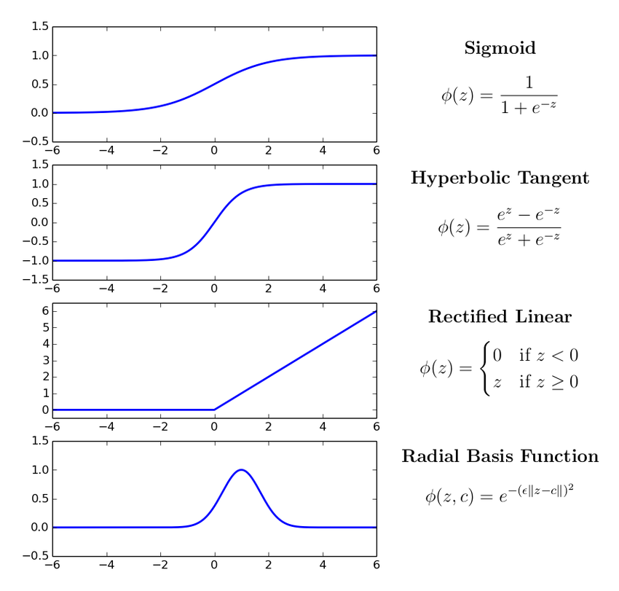
Neural networks
$$w_{1}$$
$$w_{2}$$
$$y_{i}$$
$$w_{3}$$
$$y_{i}=w_{1}x_{1}+w_{2}x_{2}+w_{3}x_{3}+bias$$
Hidden layers are essentially representing different projections/representations of the input
$$y_{i}=f(w_{1}x_{1}+w_{2}x_{2}+w_{3}x_{3}+bias)$$

Slide 72
Neural networks
Final layer then combines these various representation
How this final layer is activated will determine the task: linear for regression and sigmoid for binary classification

Slide 73
Neural networks
Can calculate a loss function with respect to the various parameters (backpropagation)

Slide 74
Neural networks
CODE (keras in R)
mod <- keras_model_sequential() %>%
layer_flatten(input_shape = c(1,3)) %>%
layer_dense(units = 4, activation = "relu")
layer_dense(1, activation = ”sigmoid")
activation="sigmoid")
Neural network: Input nodes → one hidden layer nodes → output nodes
activation="linear")

Slide 75
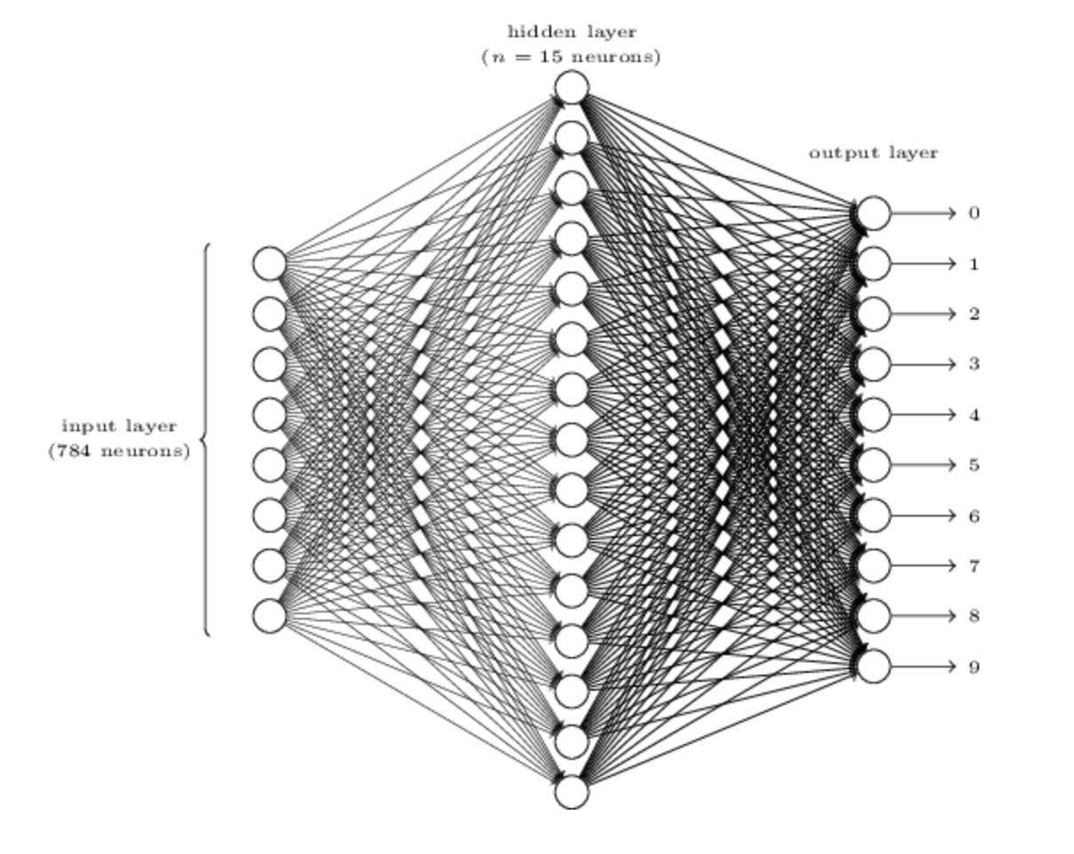
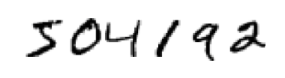
28x28 pixels
(Nielsen, Neural networks and deep learning)
Slightly more realistic neural network: digit classification (0 – 9)

Slide 76
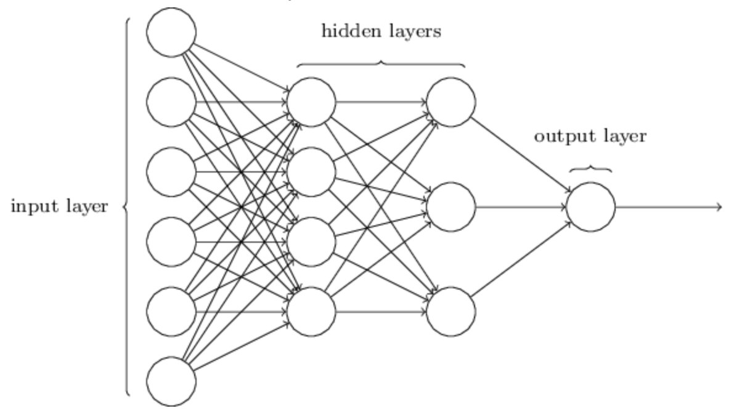
Multilayer Neural networks
(Nielsen, Neural networks and deep learning)

Slide 77
Multilayer Neural networks
(Nielsen, Neural networks and deep learning)

Slide 78
Multilayer Neural networks
CODE
mod <- keras_model_sequential() %>%
layer_flatten(input_shape = c(1,8)) %>%
layer_dense(units = 9, activation = "relu") %>%
layer_dense(units = 9, activation = "relu") %>%
layer_dense(units = 9, activation = "relu") %>%
layer_dense(4, activation = ”sigmoid")

Slide 79
Multilayer Neural networks
 | Activation | Loss | Metrics
Binary (0/1) | Sigmoid | binary_crossentropy | binary_accuracy
Multiclass/multilabel (0/1),(0/1) | sigmoid | binary_crossentropy | binary_accuracy
Categorical (0/1/2/3) | softmax | categorical_crossentropy | categorical_accuracy
Continuous (regression) | linear, none, others | mean_squared_error | mean_squared_error

Slide 80

Multilayer Neural networks
Lots of parameters
Accurate MLNNs use a lot of data. I mean A LOT!
Difficult to do all at once
Use stochastic gradient descent (process smaller sets of data at a time)
Minibatch size: number of input samples to used in stochastic gradient descent (optimiser)
Epoch: one full sweep through all minibatches
Loss function?
Minibatch
All data

Slide 81

https://towardsdatascience.com/

Slide 82
Convolutional neural networks
(Nielsen, Neural networks and deep learning)

Slide 83


Convolutional neural networks
(Nielsen, Neural networks and deep learning)
Image (set of pixels)
Convolution layer
Scans across the image using a filter to create a feature map

Slide 84

Convolutional neural networks
Image (set of pixels)
Convolution layer
Scans across the image using a filter to create a feature map

Slide 85

Convolutional neural networks
https://adeshpande3.github.io/A-Beginner%27s-Guide-To-Understanding-Convolutional-Neural-Networks/

Slide 86


Convolutional neural networks
https://adeshpande3.github.io/A-Beginner%27s-Guide-To-Understanding-Convolutional-Neural-Networks/

Slide 87

Convolutional neurual networks
https://adeshpande3.github.io/A-Beginner%27s-Guide-To-Understanding-Convolutional-Neural-Networks/

Slide 88

Convolutional neurual networks
Usually want to learn more than one feature map
CODE
mod$add(Conv2D(filters = 3, kernel_size = c(4, 4),input_shape = c(28,28,3)))

Slide 89


Pooling layers
CODE
mod$add(MaxPooling2D(pool_size=c(2, 2)))

Slide 90

Convolutional neural networks
Human?
Fab hair?

Slide 91

Convolutional neural networks
Human?
Fab hair?

Slide 92

Convolutional neural networks
Human?
Fab hair?

Slide 93
Convolutional neural networks
Human?
Fab hair?

Slide 94
Convolutional neural networks
Human?
Fab hair?

Slide 95
Convolutional neural networks
Human?
Fab hair?

Slide 96
Convolutional neural networks
Human?
Fab hair?

Slide 97


Task
Implement a convolutional neural network that can recognise images of Rick Sanchez vs from the TV series Rick & Morty
Data from https://masterofallscience.com
Understand the basic parameters
Compare different network architectures … don’t just use the default architecture try changing it. Let’s see who can get the best performance
Compare your model to the earlier ANN.

Slide 98
Predictive features?
DeepExplain
(python)
A demo python script can be found in Python subfolder

Slide 99
Predictive features?

Slide 100
Predictive features?

Slide 102
CODE
mod$add(Conv2Dtranspose(filters = 3, kernel_size = c(4, 4))
mod$add(UpSampling2D(size=c(2,2)))

Slide 103

CNN
Dinosaur?
Piglet?
Input
Compressed representation

Slide 104
Upscaling/Generators
High res. output
Low res. Input or noise

Slide 105
Autoencoders
Input
Output
Compressed representation

Slide 106
Autoencoders - denoising
Noisy input
Clean output

Slide 107

Autoencoders - transformations
Inputs
High res. output

Slide 108



Variational autoencoders
Rampášek et al.
Jin et al
Notes:
Rampášek

Slide 109

Generative Adversarial Networks
CNN
Image credit: Thalles Silva

Slide 110
Split data: test / validation / prediction
Architecture of CNN and other types of network still an area of active research
When in doubt don’t be a hero look at the best performing architectures and borrow them (transfer learning)
Some of the best image classifiers use millions of images
Do you have millions of data points?
Can do a reasonable job with 10k images
Rule of thumb: at least 1000 images per class
Augment your data!
Inherent biases in datasets

Slide 111


Split data: test / validation / prediction
Architecture of CNN and other types of network still an area of active research
When in doubt don’t be a hero look at the best performing architectures and borrow them (transfer learning)
Some of the best image classifiers use millions of images
Do you have millions of data points?
Can do a reasonable job with 10k images
Rule of thumb: at least 1000 images per class
Augment your data!
Inherent biases in datasets

Slide 113
PULSE: Self-Supervised Photo Upsampling via Latent Space Exploration of Generative Models

Slide 115
Generative Pre-trained Transformer 2 (GPT-2) is an AI developed by OpenAI in February 2019. GPT-2 uses deep learning to translate text, answer questions, summarise passages and generate text output

Slide 116

Generative Pre-trained Transformer 2 (GPT-2) is an AI developed by OpenAI in February 2019. GPT-2 uses deep learning to translate text, answer questions, summarise passages and generate text output
Final task: You’ve learned about some of the various basic methods in ML/AI now go read about bias in AI and ML / ethical AI
Table from Sheng et al. (2019)

Slide 117
Tasks
Start with document: docs/logistic-regression.html
Can open an interactive workbook in R: 09-logistic-regression-gaussian-processes
In Section 3.1 we use linear regression to analyse Arabidopsis thaliana gene expression time series data following inoculation with the necrotrophic fungus Botrytis cinerea

Slide 118
Tasks
Start with document: docs/logistic-regression.html
Can open an interactive workbook in R: 09-logistic-regression-gaussian-processes
In Section 3.1 we use linear regression to analyse Arabidopsis thaliana gene expression time series data following inoculation with the necrotrophic fungus Botrytis cinerea
Fit linear regression model
Predict values at new locations
Fit more complex models
Use sum squared errors on held out data to identify the best model

Slide 119

Tasks
As well as measuring gene expression we also have a measure of infection status (binary data)
Use logistic regression to look for marker genes that are indicative of infection status (Section 1.2)
Main task: As before the main task is to use logistic regression to identify marker genes predictive of infection status. How would you write this up?

